Slide 1
Use what you learned about color theory, and put it into practice in the next project!
NEW PROJECT

Slide 2
Painted Pages Project
We will be painting on vintage book pages
Each person will make 4 pages
Each page will have a clear color concept
Options:
Complementary
Monochromatic
Warm or cool

Slide 3
EXAMPLES
Example…if you pick complementary colors one painting may be yellow and purple, the other painting may be green and orange, or blue and red. Each painting would have two colors in it.
Example… A monochromatic painting would use only one color per painting with different shades and tones. Both pages would have a different color on it. You can use any two colors for either of the paintings.
Example…warm and cool colors would have one painting in warm colors (orange, yellow, red) and the other painting would be in cool colors (blue, green, purple).

Slide 4
Requirements
Paint a subject… person, place or thing!
Animals. Landscape. Flower. Elephant. Moon. Portrait. Tree. Cityscape. Car. Bike. Mountain. Whale. Sloth. Baby. Abstract design. Butterfly. Sunflower. Symbol. Bear. Awkward face. Home. Sports. Music. The body. Squirrels. Food. Snow.
Make four paintings connect in some way. Example…the seasons, animals, family….it can connect through opposition.
Use some aspect of the text
highlight a word, use the words to outline something…get creative. Create a secret or not so secret message if you want!
Make a rough draft
Come up with a few ideas and play around with them until you are set on your idea!

Slide 5
Painted Pages Project
This project is intended to be a gift for someone. Not your mom, Dad, BF, GF, Brother, Sis,
Bff, but someone you may not even know….
Maybe a neighbor you have never met, maybe someone at this school you would
Like to reach out to. You could give it to someone that you know but don’t really know,
Like the clerk at the grocery store, or someone you see everyday at the bus stop.
Start looking in your life at all of the people you interact with, those who are not friends yet.
Then pick someone to give your painting to.

Slide 6
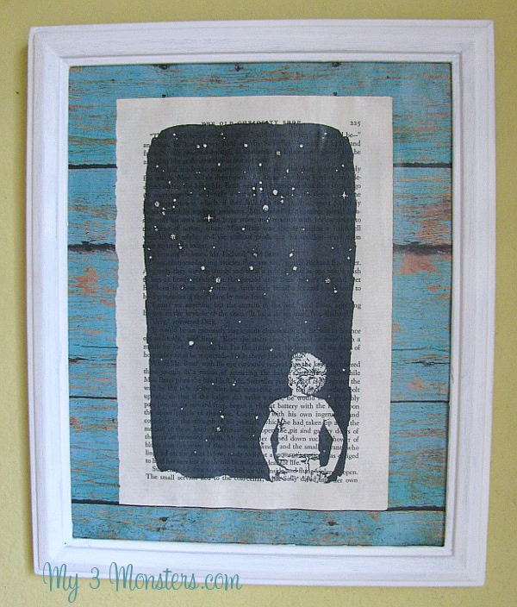

Slide 8
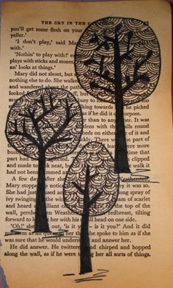
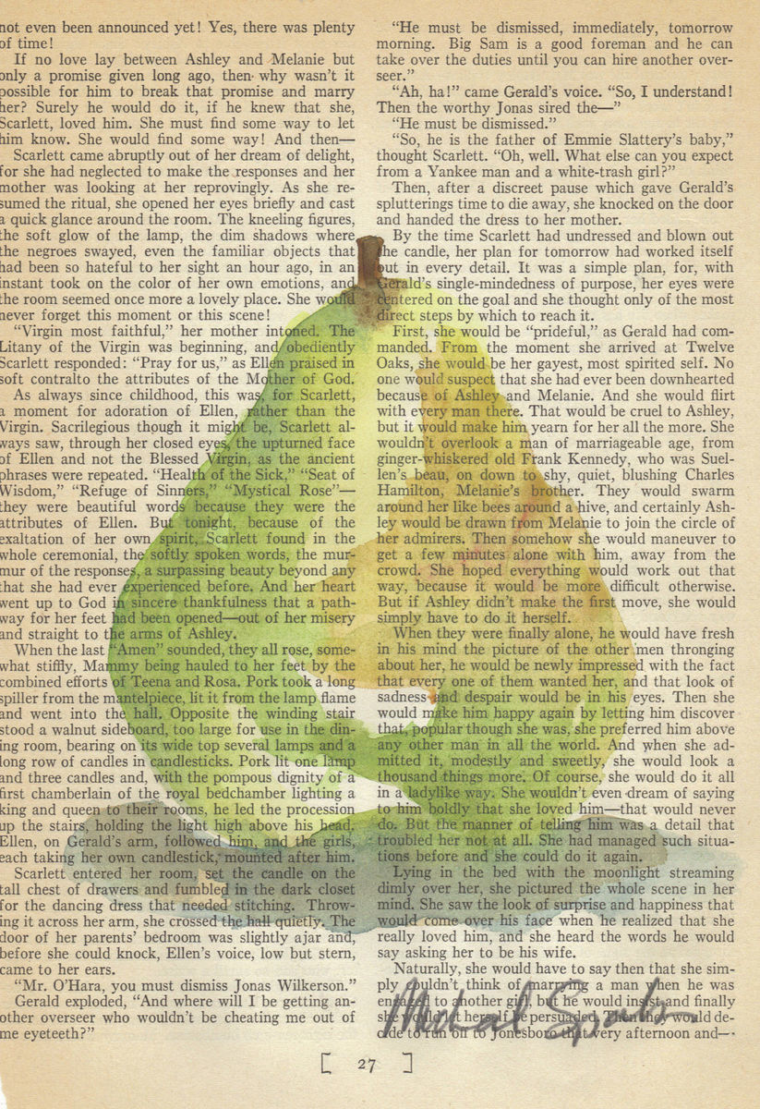

Slide 9
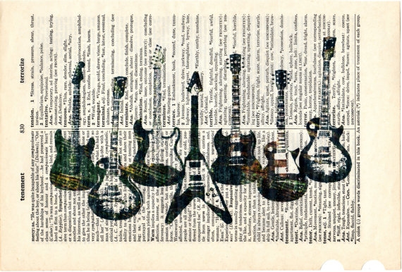

Slide 11
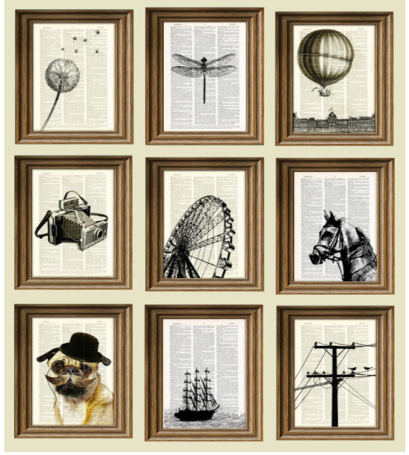

Slide 12
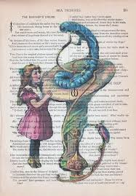
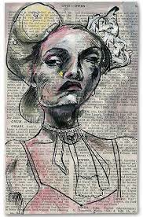

Slide 13
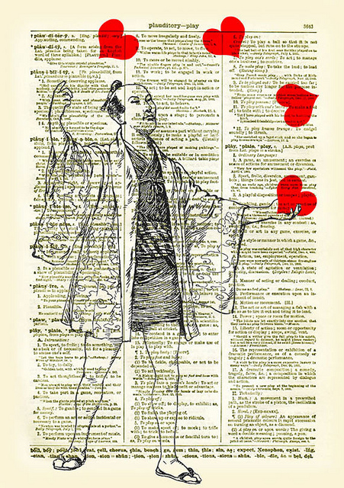

Slide 14
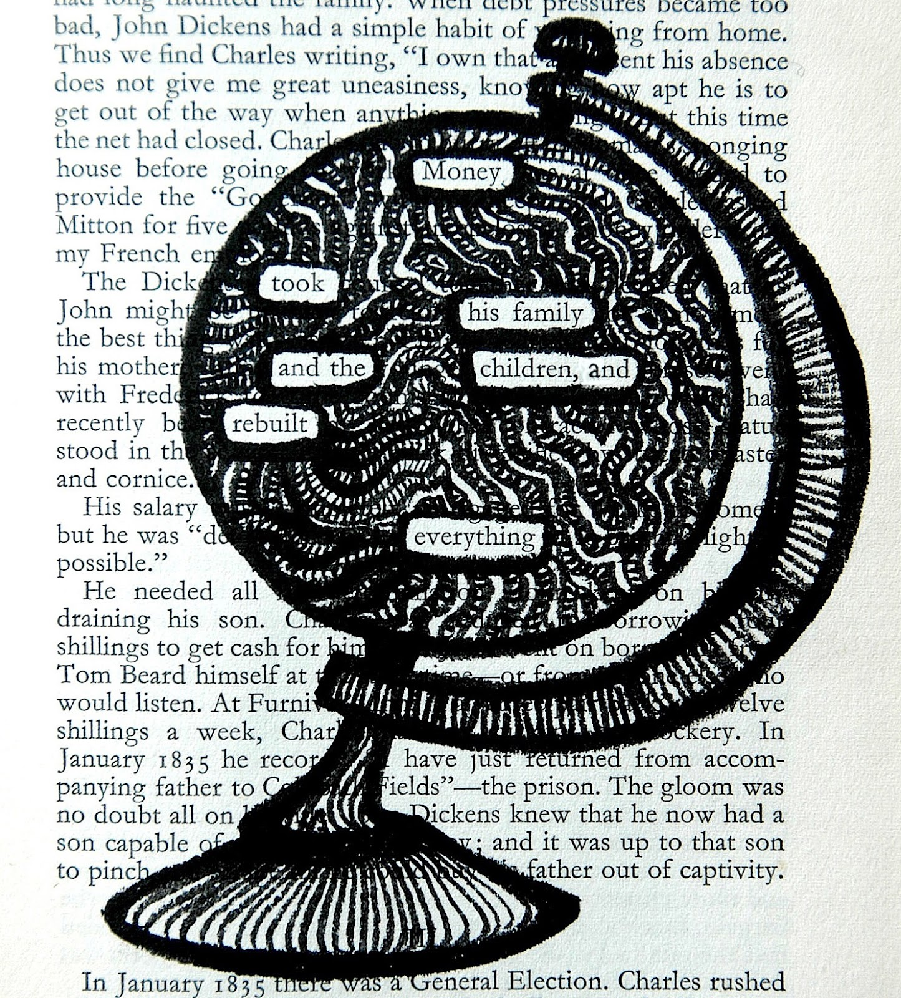
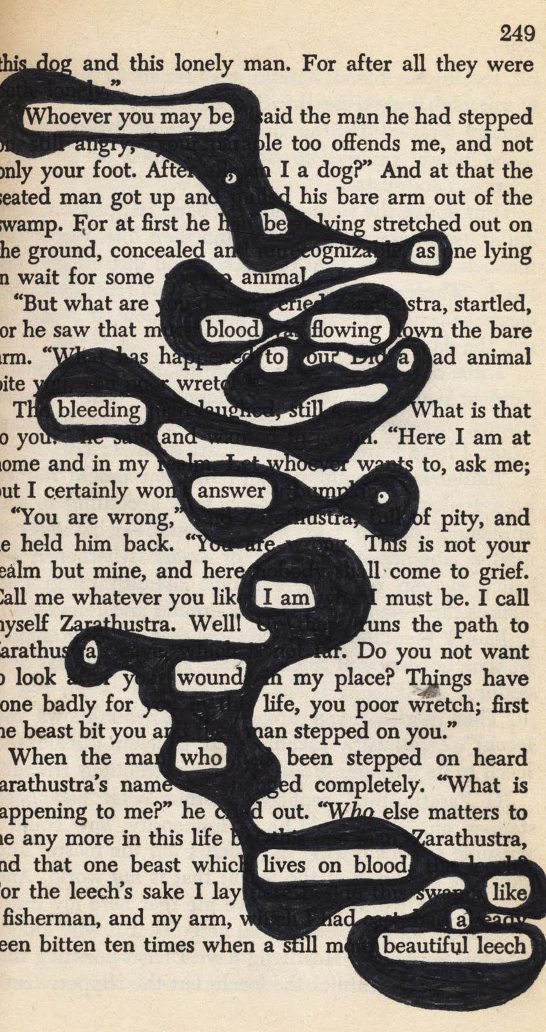

Slide 16
