Slide 1
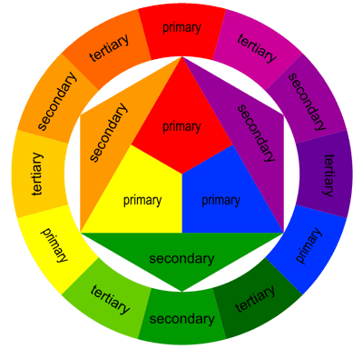

Slide 2
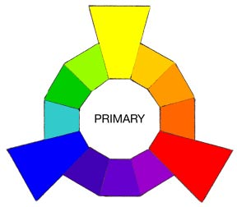
Primary Colors are the root of every other hue imaginable.
*Think of the three Primaries as the Parents in the family of colors.

Slide 3
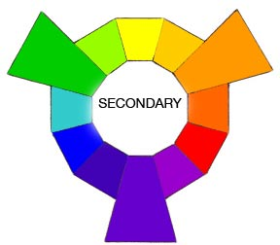
Yellow + Red = ORANGE
Red + Blue = VIOLET or PURPLE
Blue + Yellow = GREEN

Slide 4
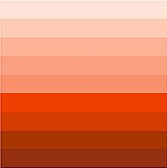
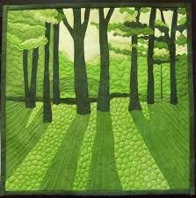
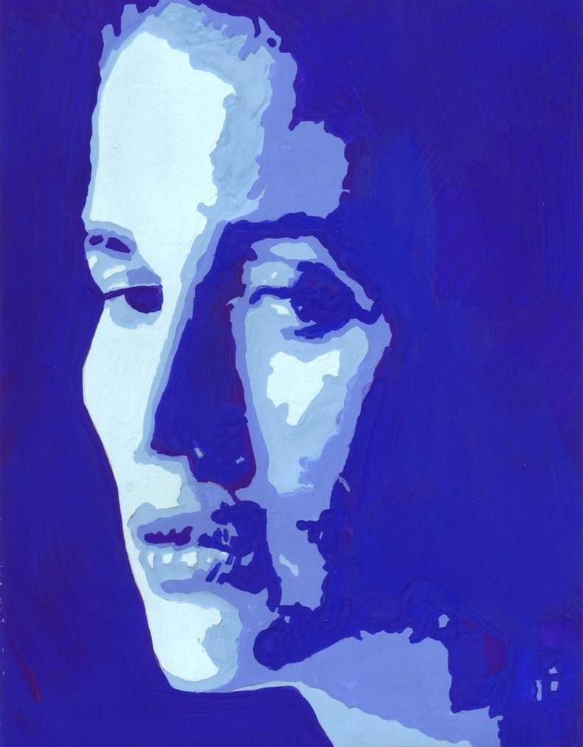
Monochromatic colors

Slide 5
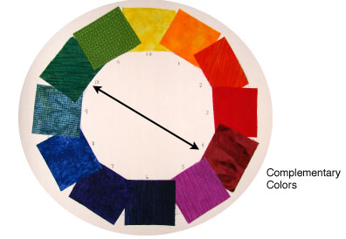
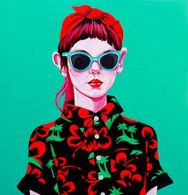
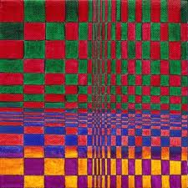

Slide 6
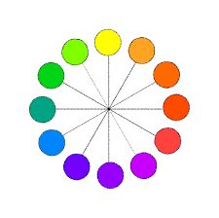
What you need to know…
Primary Colors
the root of every other hue imaginable.
Complementary colors
colors directly opposite each other in the color spectrum.
Secondary Colors
a color resulting from the mixing of two primary colors. (Green, orange, purple)
Monochromatic colors
tints, tones, and shades of a single hue.

