Slide 1
Drawing Upon The Story of Your Life
Purpose- To articulate your personal story though expressive drawing.
Students will document their past, present and future dreams, by making a descriptive art piece through symbolism, color and creativity.
Brainstorm
Think about your life…where do you come from? What is your family like? Do you have animals? What are you passionate about? What is your favorite thing to do? What makes you laugh? What makes you cry? What emotion are you? If you could be one word what word would it be? What is your personal symbol? What is your favorite color, smell, food, season, and animal? Who are you for others? What are your dreams? What does your future hold? What kind of life will you live when you get older? Will you help people, animals, or the environment? Are you a peacemaker? What is your heart like? What defines you? Who will you become?

Slide 2
Turn your paper to vertical.
Draw an outline of your body. Have it fill 75% of the page from head to toe.
Fill the entire body with imagery. Fill the entire background with the scenery of your life at different times.

Slide 3
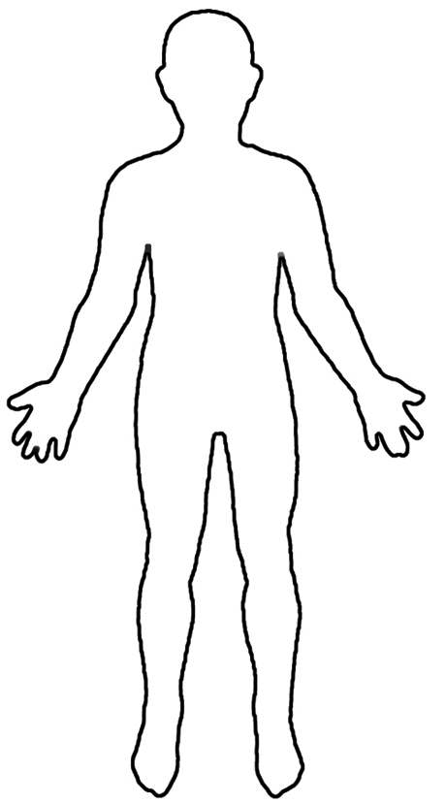
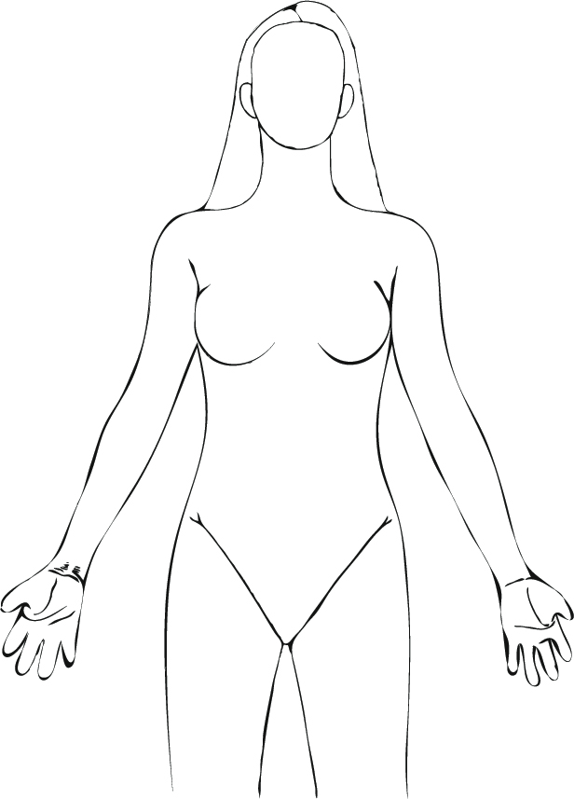

Slide 4
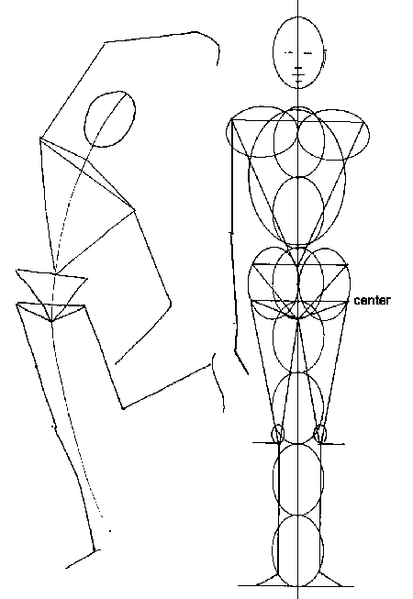
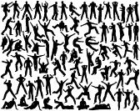
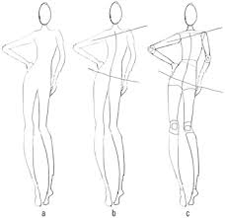

Slide 5
Begin at the feet and draw your childhood, birth and early life. Birth-6 years old.
From the knees to the waist, draw your life from ages 6-11.
From the waist to the heart draw your present life.
From the heart up to the throat, draw your future as a young adult. What are your dreams, goals, aspirations and future plans? You are so needed in this world, who will you become?

Slide 6
Future Goals
Symbol of expression
Create a symbol that defines you!
NOW
6-11 years old
Birth -6 years

Slide 7
Symbols
At your heart, make a personal symbol. Make the heart symbol clear, and try to translate your core, truth, power, freedom, love, creativity, and personal expression in a symbol of your choice.
At the throat draw a symbol of your favorite form of expression. Please draw the way you express your voice, opinions and expression.

Slide 8
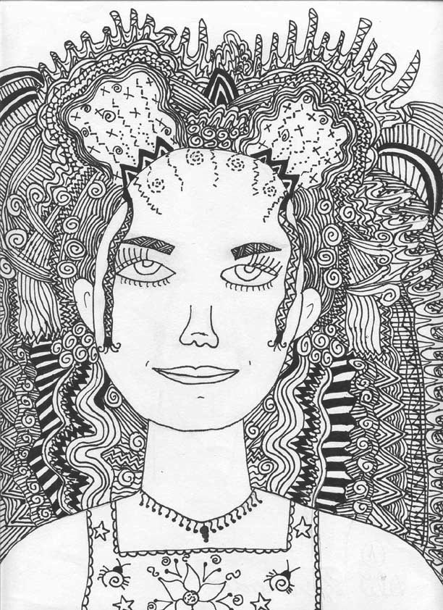
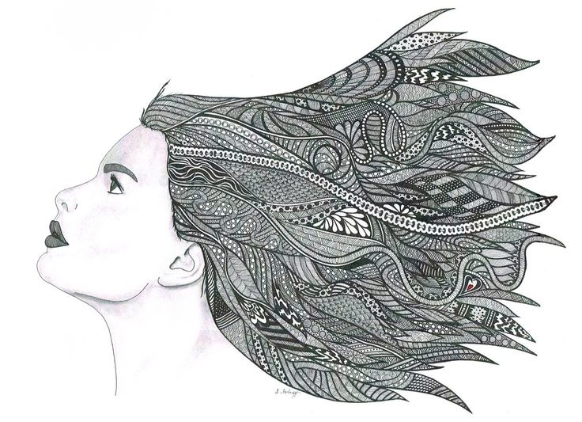
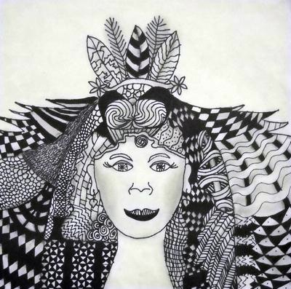
Include dreams and goals in the hair! It can be symbolic and creative!

Slide 9
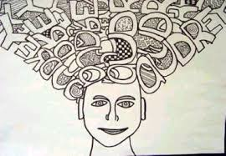
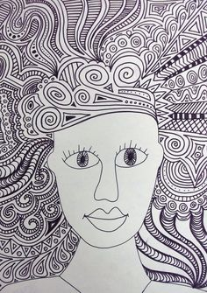
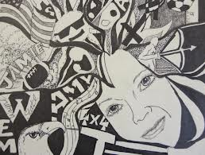

Slide 10
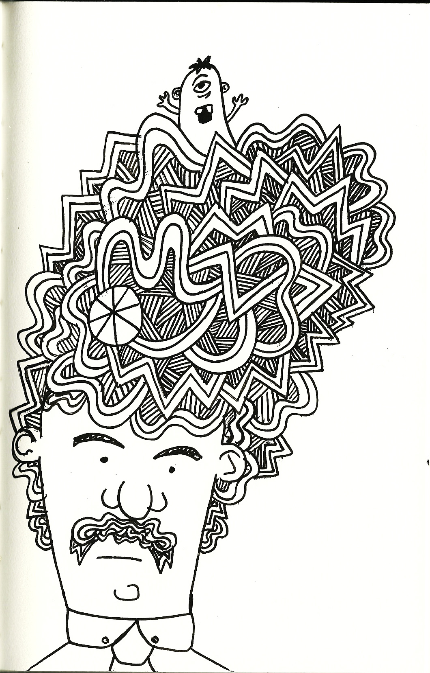
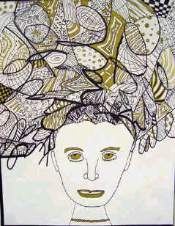
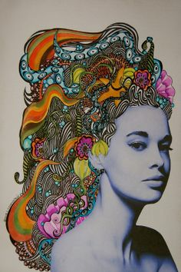
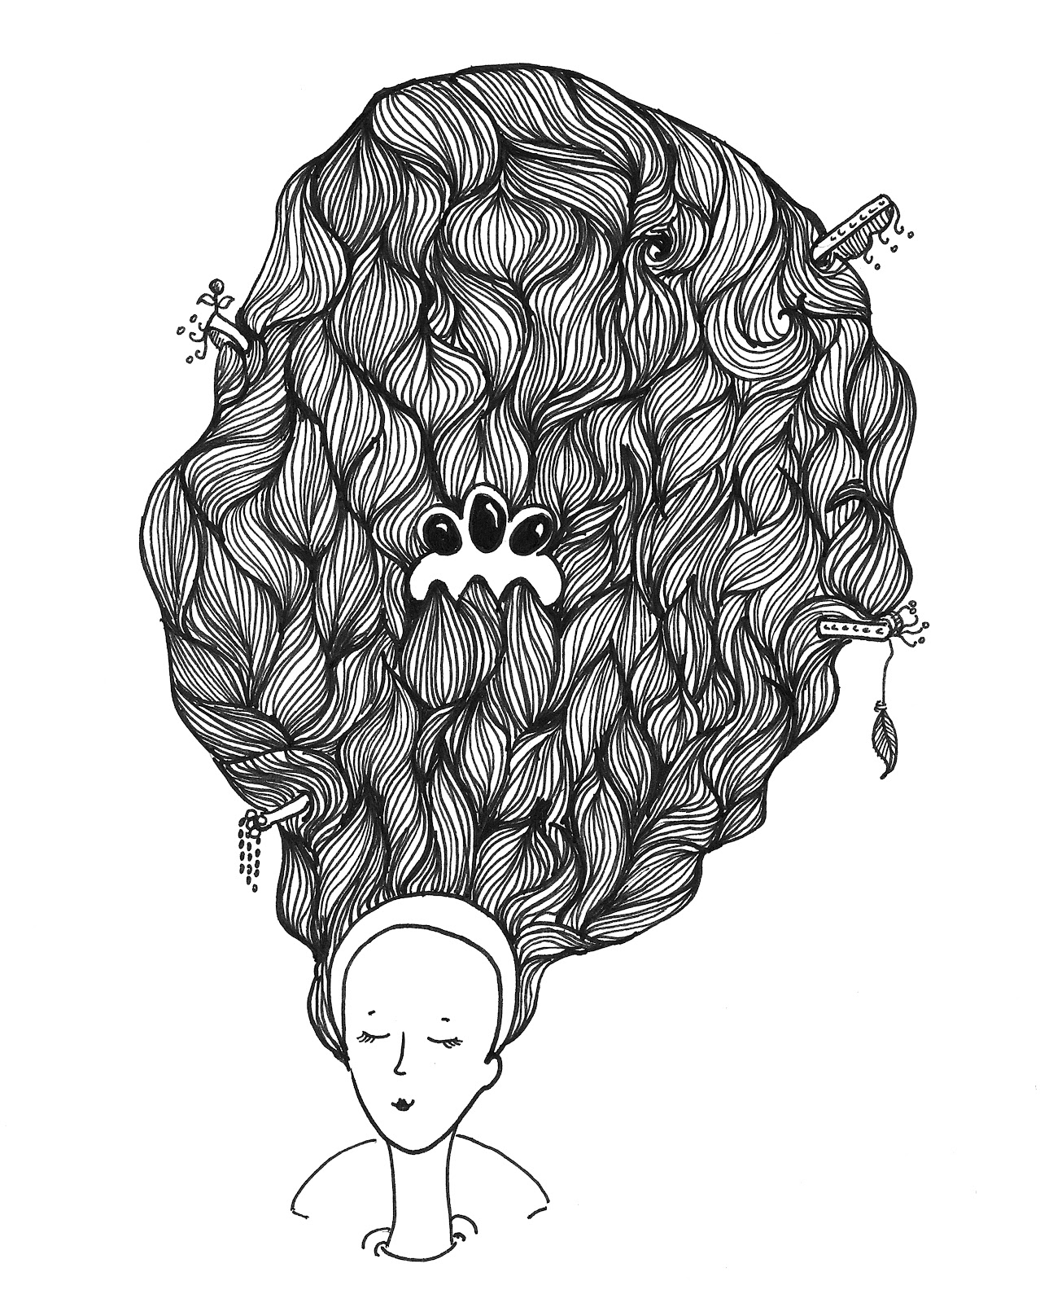
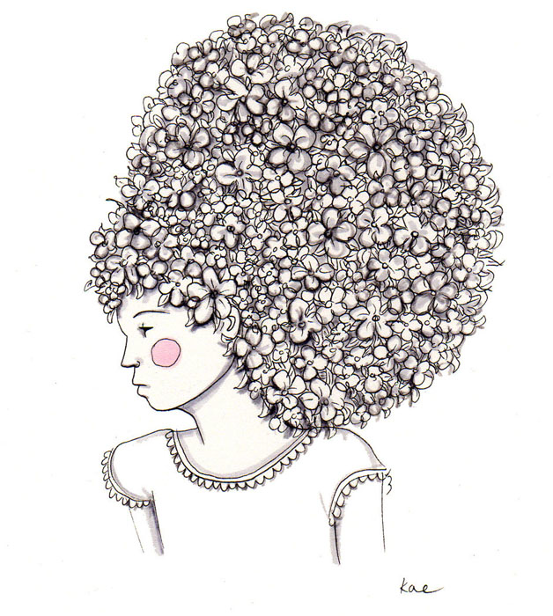

Slide 11
Rubric for Drawing Upon the Story of Your Life.
The entire page is filled with creative lines, symbols and meaning.
The body fills 75% of the page from head to toe.
At the heart, a personal symbol is articulated visually.
At the throat, your center of expression, a symbols is in place to
show how you express your voice.
The hair/background articulates your future goals, dreams and
aspirations clearly and creatively.
The entire piece demonstrates good craftsmanship and tells a story from head to toe!

