Slide 1
Modern Art Movement
1870-1970

Slide 2
ART MOVEMENTS
An art movement is a style in art that has …..
Specific common goal
A group of artists that create art in a similar style
A restricted period of time (usually a few months, years or decades).

Slide 3
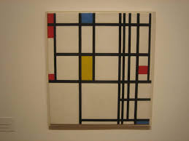
MODERN ART
Modern art includes works produced during the 1870s to the 1970s. The artists were known for having new fresh ideas.

Slide 4
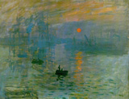
IMPRESSIONISM 1870-1880
Impressionism is about the nature of light falling on surfaces. It expresses the modern quality of the paintings.

Slide 6
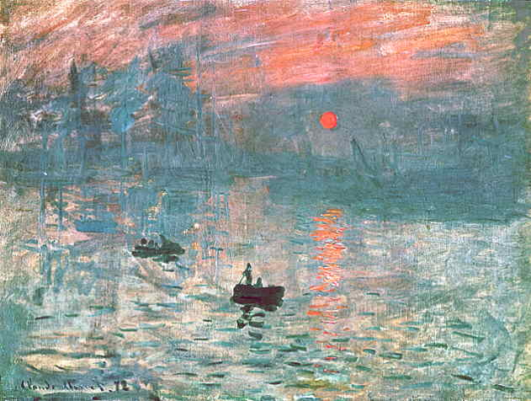

Slide 8
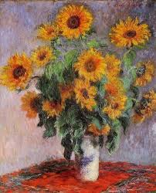
FAMOUS IMPRESSIONISTS
Monet
Cezanne
Degas
Renoir

Slide 9
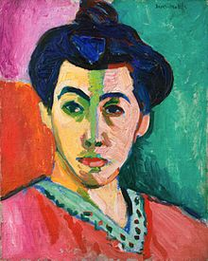
FAUVISM-1900-1910
Fauvism is the style of les Fauves (French for "the wild beasts"), their works emphasized painterly qualities and strong color over realism

Slide 10
Examples

Slide 11
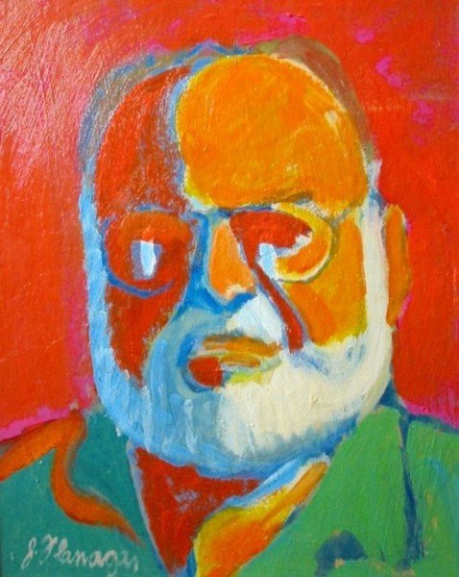

Slide 12
Cubism 1907-1914
Cubism is an art movement pioneered by Georges Braque and Pablo Picasso. It has been considered the most influential art movement of the 20th century.

Slide 13
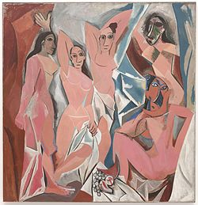
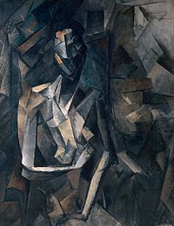

Slide 14
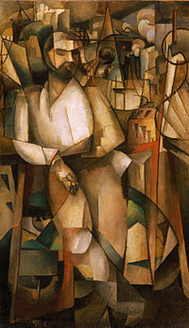
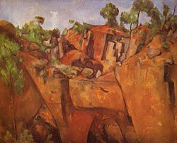

Slide 15
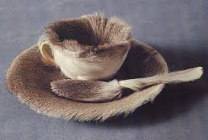
Dadaism 1916-1923
Dada was born out of negative reaction to the horrors of World War I.
Dada rejected reason and logic, prizing nonsense and irrationality

Slide 16
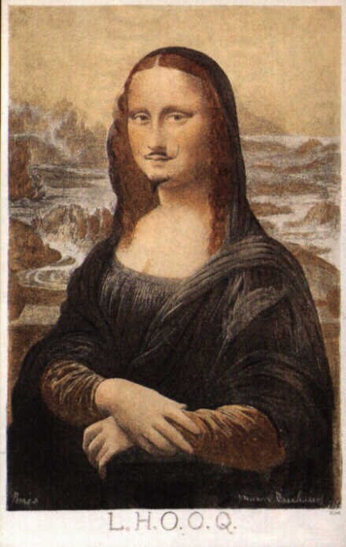
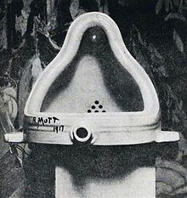
440 × 695 - dieselpunks.org

Slide 17
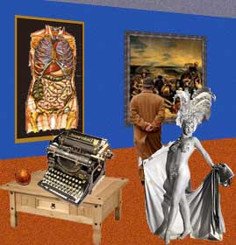
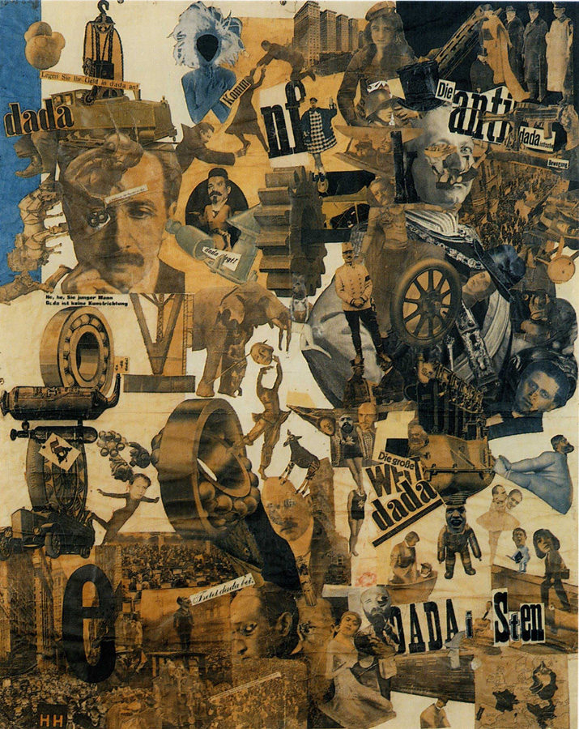

Slide 18
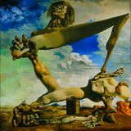
Surrealism 1922-1939
Surrealists focused on the unconscious. They believed that Freud's theories on dreams, opened doors to the authentic self and a truer reality (the "surreal").

Slide 19
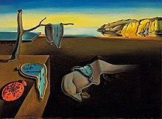
Salvador Dali

Slide 20
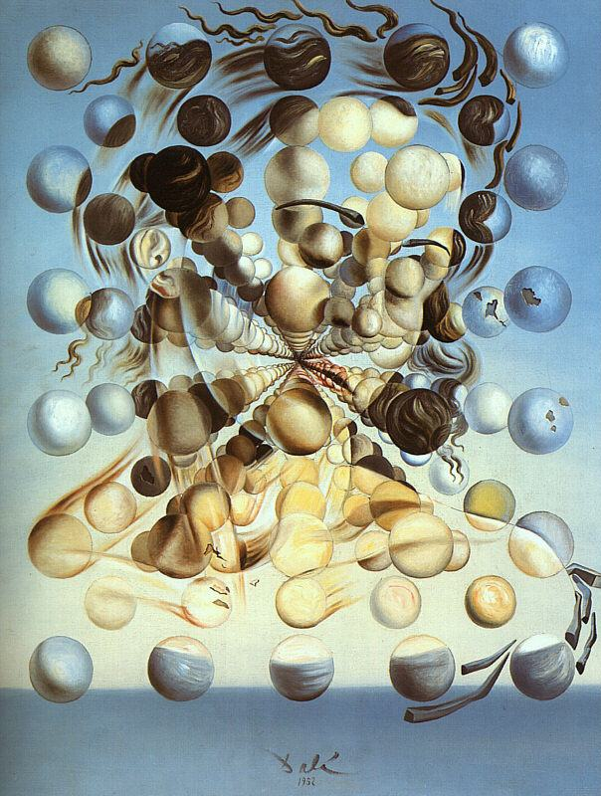
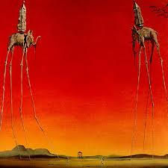

Slide 21
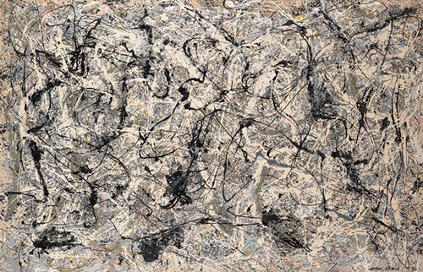
Abstract Expressionism 1940’s-Present
After World War II characteristics- messiness and extremely energetic applications

Slide 22
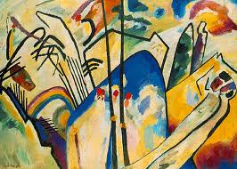
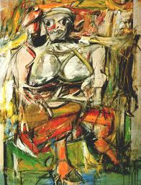

Slide 23
Pop Art mid 1950’s-Present
Pop Art appreciates popular culture, or what we also call “material culture.”

Slide 24
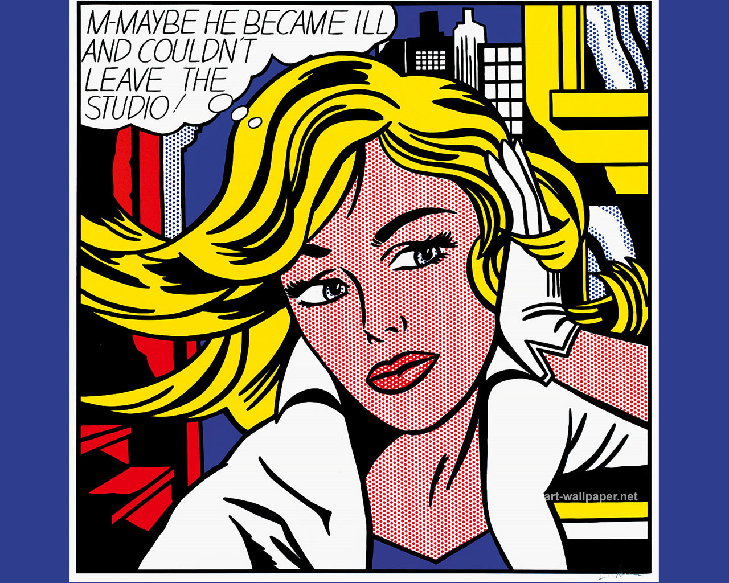
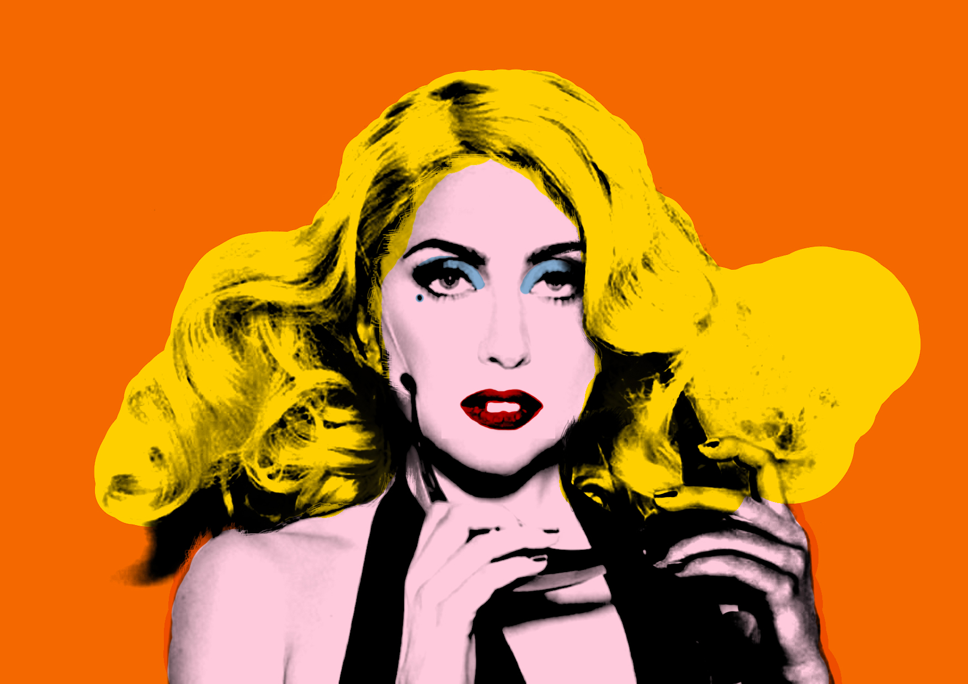

Slide 25
Op Art 1960-Present
Op Art is comprised of illusion, and often appears - to the human eye - to be moving or breathing due to its precise, mathematically-based composition

Slide 27
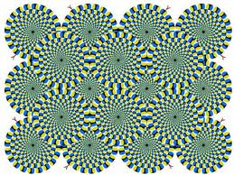

Slide 28
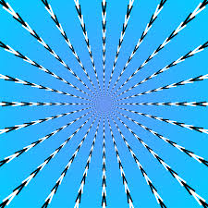

Slide 29
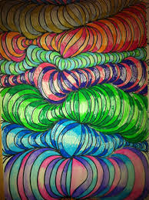
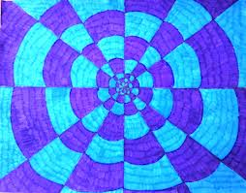
CREATE YOUR OWN!!!!!

