Slide 1
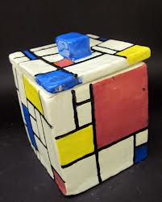
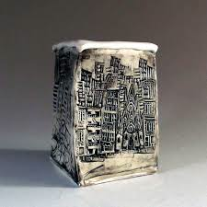
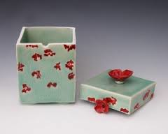
SLAB BOX

Slide 2
You will learn
How to create a slab box
How to slip and score
How to add designs to your ceramic box
Ceramic vocabulary
The steps in constructing, glazing, and firing clay

Slide 3
How do you make a slab box?

Slide 4
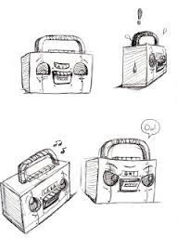
Come up with a design!

Slide 5
Or…..use stamps as texture

Slide 6
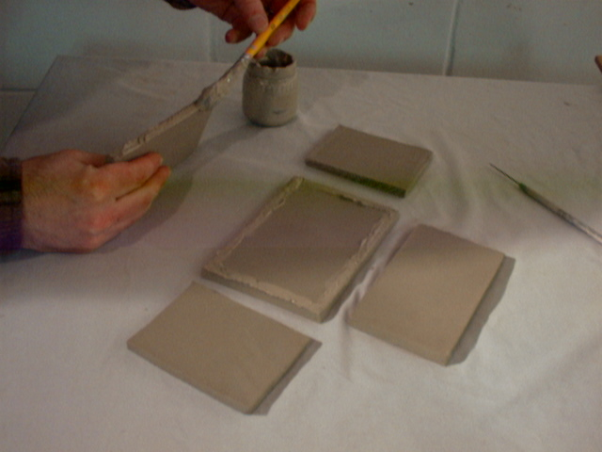
Use a template to cut your pieces
Slab Construction
Creating a slab is the base of this project. You will need to roll out slabs and cut 4 (4×5) pieces and 2 (4×4) pieces.

Slide 7
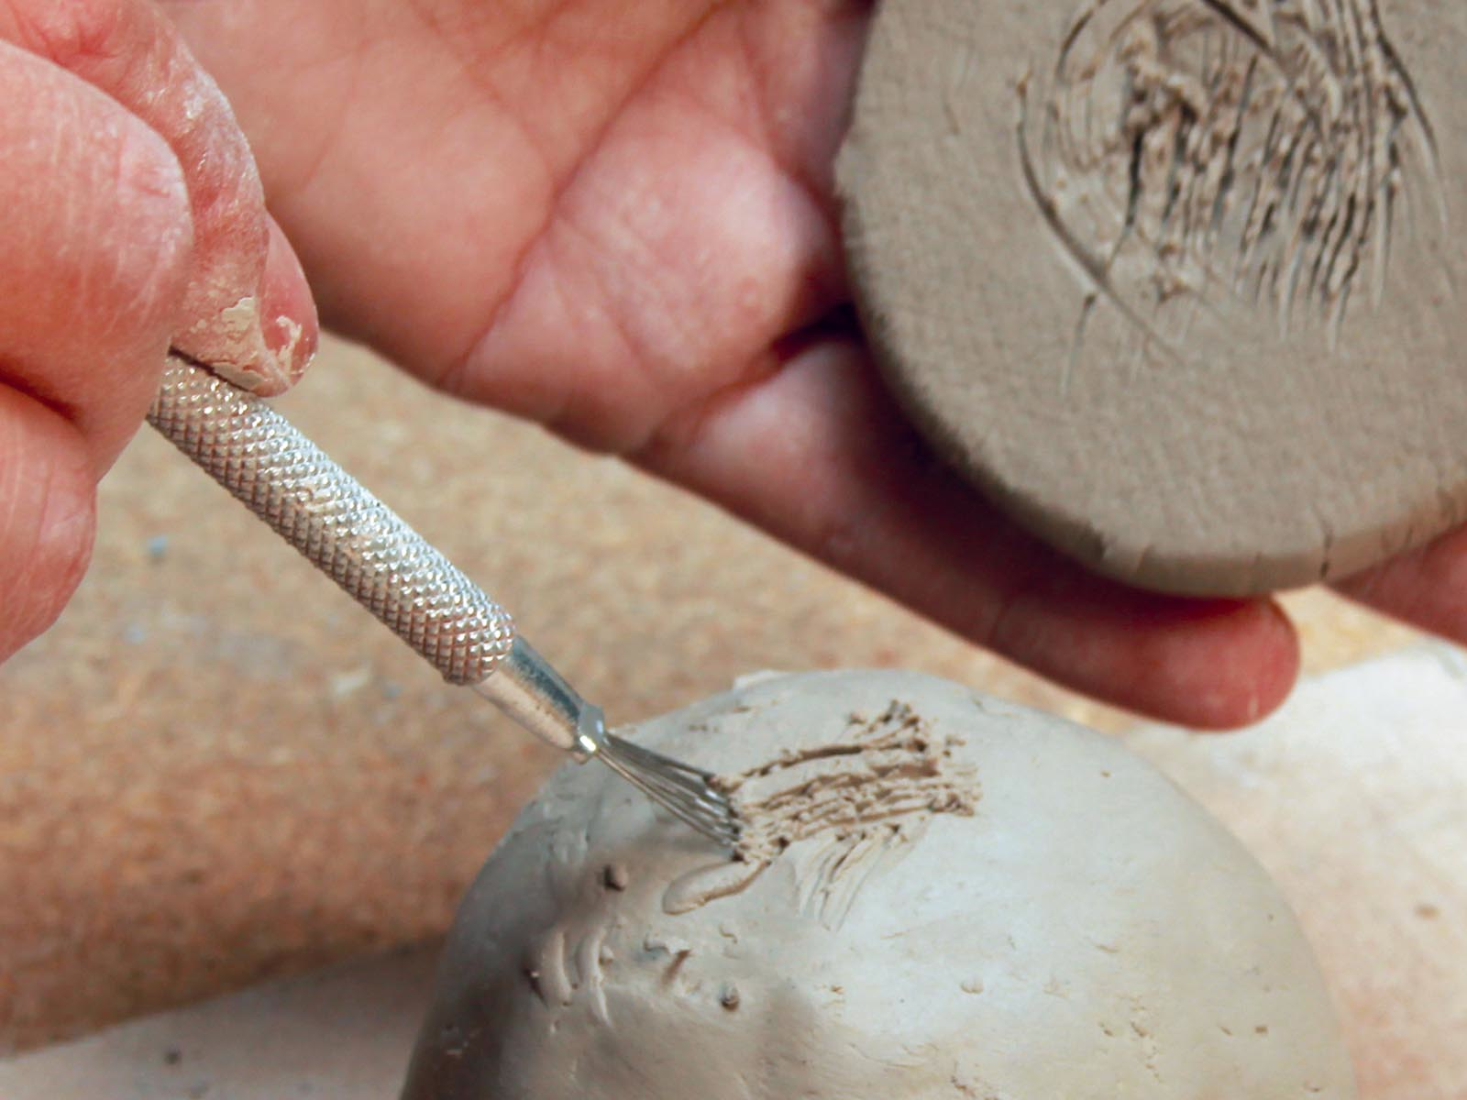
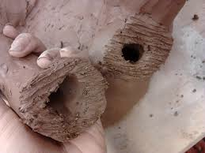
Slip and Score
Slip is a mixture of water and clay. It works as glue for ceramics. You will need to rough up the edges before connecting them, this is called scoring. Use a ceramic cutting tool or fork to create cuts on both sides of the connecting pieces before applying slip.

Slide 8
Design Lid
Lid
You will be creating a complete cube at first with no opening. This will ensure that all pieces fit together and you have a solid box. Once you have a cube you are ready to cut the lid out. Go about an inch down and make a cut all the way around at about a 45 degree angle. You can add designs to your cut as well (zigzag).

Slide 9
Use addition of clay

Slide 10
….ADD A FOOT

