Slide 1
Step 1
Design your box idea. Include lid, foot and design layout.
Step 2
You will create all sides of your box using the slab machine.
Find a board to keep pieces on and a plastic bag to store them in. Get newspaper to divide slabs on the board.
Step 3
Once your pieces are leather hard you will need to start building!
Each wall will need to be scored and slipped before attaching together.
You will need to create a coil and weld it together on the inside of each connecting piece
Step 4
Cutting the lid and finishing coil work!
With your cube decided how you want to cut the lid with a pencil lightly draw on your design on the outside.
Once you have decided on a design, use a cutting tool and slice at a downward 45 degree angle.
Remove lid carefully not to move the walls and coil the inside of the lid

Slide 2
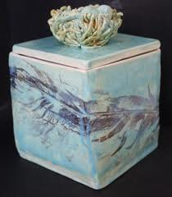
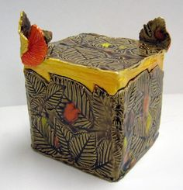
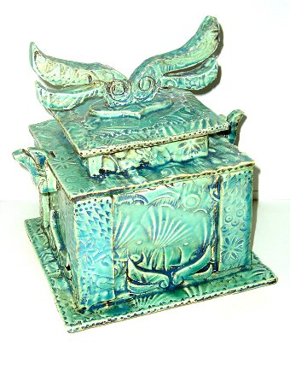
Step 5
Once the box and lid are finished you can add texture and design to your box!
Make sure that if lines are carved that the edges are smoothed out.
Clay edges that are pointed will be sharp
when adding pieces such as handles or feet make sure you slip and score first.
Step 6
Let piece fully dry (bone dry) and they will be fired for the first time.
Once it is fired you will paint the bisque ware or glaze it and get ready for the final firing.

Slide 4
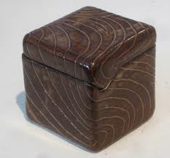
It can be simple….

Slide 5
Or complex

Slide 6
EXAMPLES

Slide 7
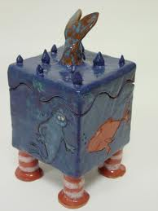
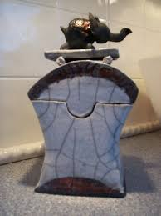
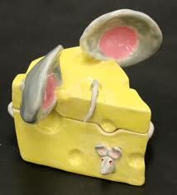

Slide 8
The golden rules of Ceramics
Clay must be thoroughly covered up with a plastic bag to keep it from drying out. This applies to works in progress and moist clay.
Clay dust can be harmful if you are exposed to it for long periods of time, so keep your area clean, clay scraps off the floor and clean with water and a sponge.
Clay can be no thicker then your thumb.
In order for clay to stick together it MUST be scored and slipped together while the clay is moist or leather hard.
Wedge clay to remove air bubbles, achieve uniform consistency, and to line up the particles of clay.
Trapped air can cause clay to explode. So hollow out sculptural forms and put needle holes from the bottom so air can escape.
Don't glaze the bottom of a piece.
Always wash the piece before glazing.
Always handle your project with two hands at all times. In other words BE CAREFUL it’s your hard work.
NEVER HANDLE ANOTHER PERSONS WORK EVEN IF IT LOOKS COOL!

