Slide 1
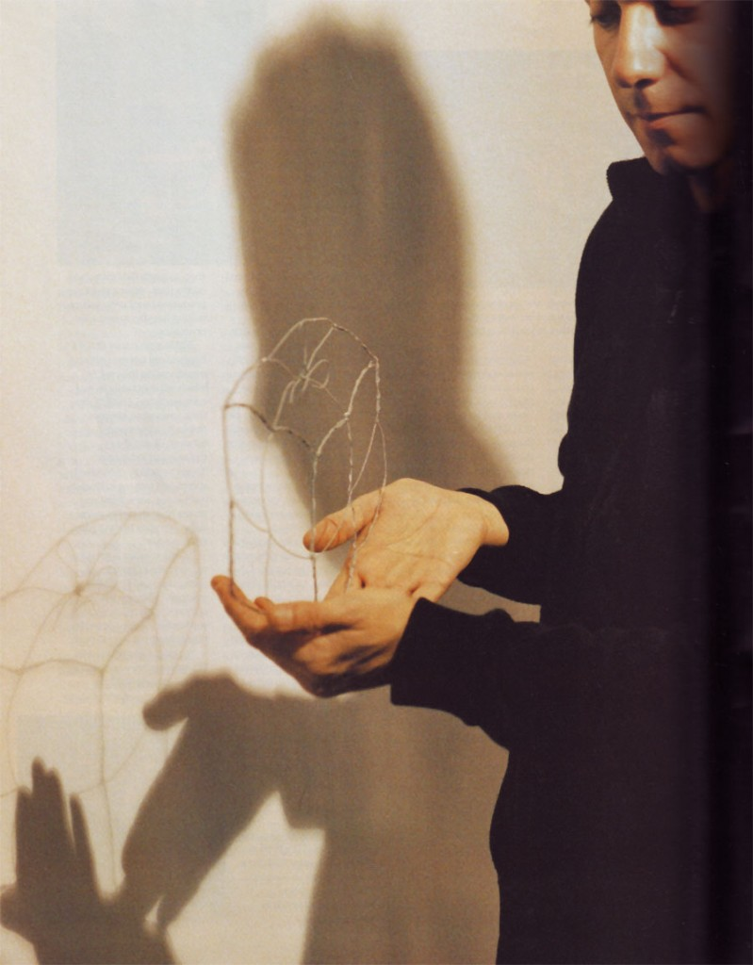
The Medium is the Message

Slide 2
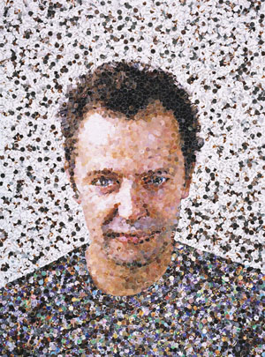
Vik Muniz,
Self Portrait

Slide 3
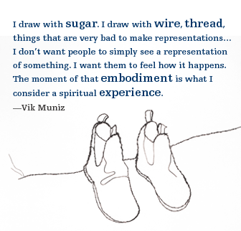

Slide 4
“The Medium is the Message”
The specific medium an artist uses influences the message found in the artist’s creation.
Any medium the artist intentionally chooses to use is an additional form of communication.

Slide 5
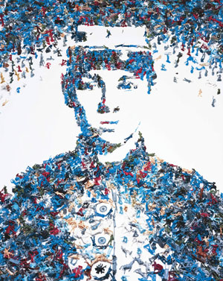
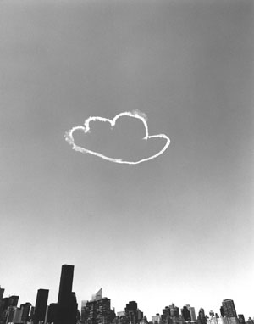
Vik Muniz, Toy Soldier (Monads), 2003.
Vik Muniz, Cloud Cloud, Manhattan
(Pictures of Clouds) (detail), 2001

Slide 6
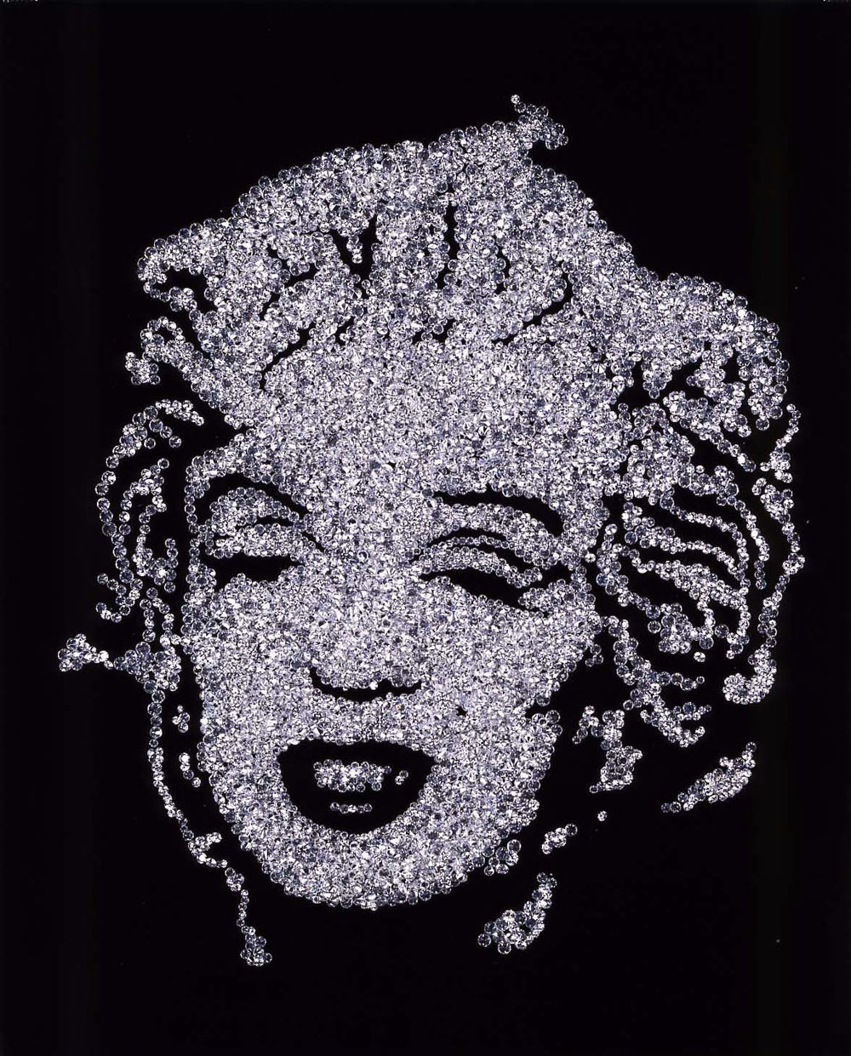
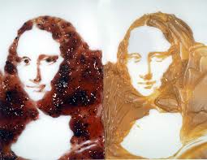

Slide 7
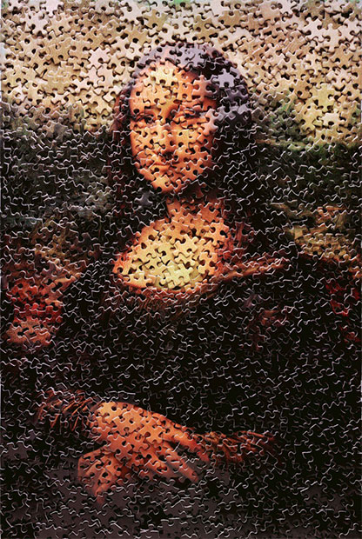
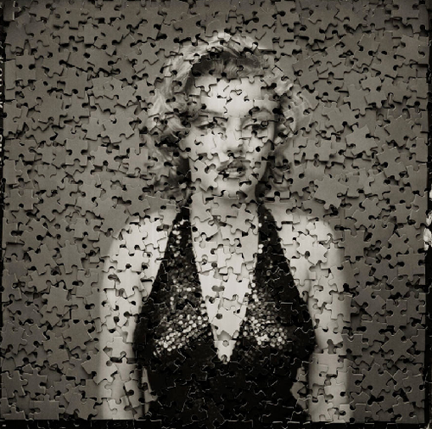

Slide 8
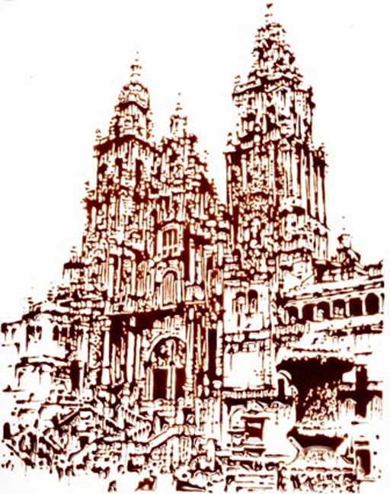
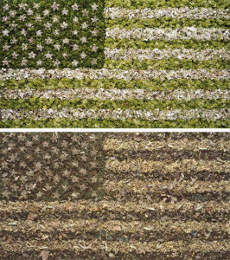
Grass
Chocolate

Slide 9
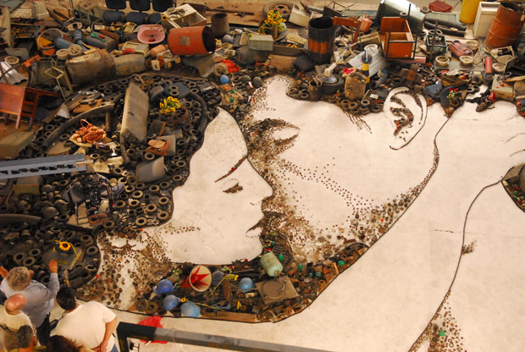

Slide 10
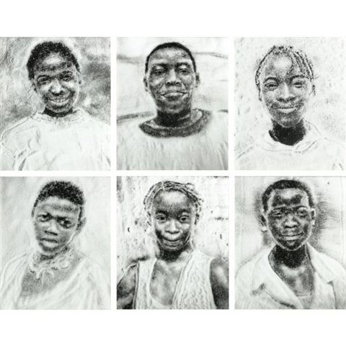

Slide 11
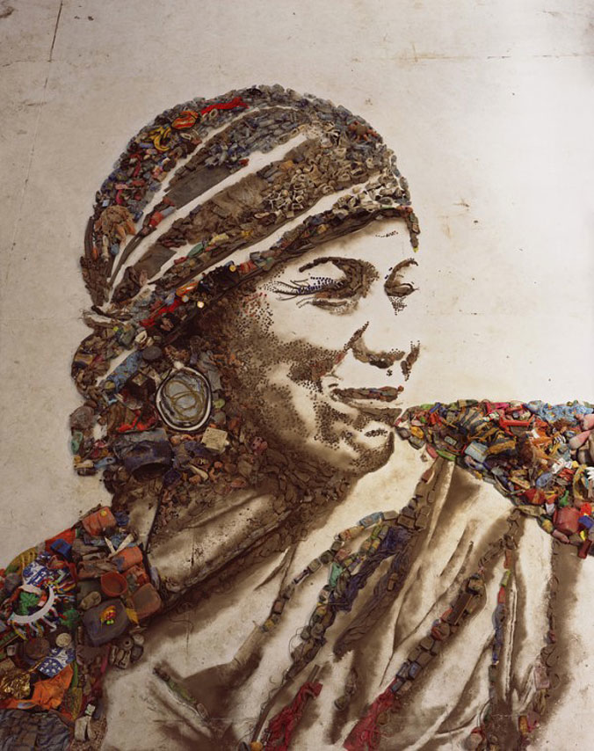
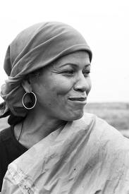
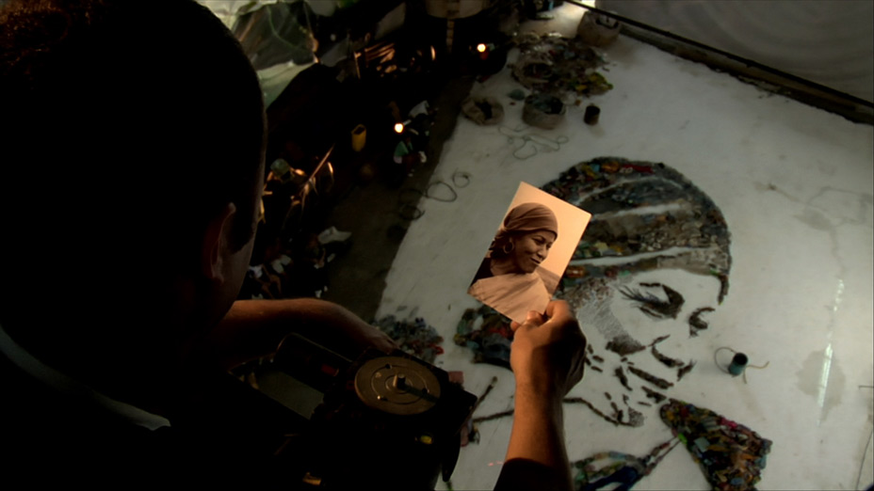

Slide 12
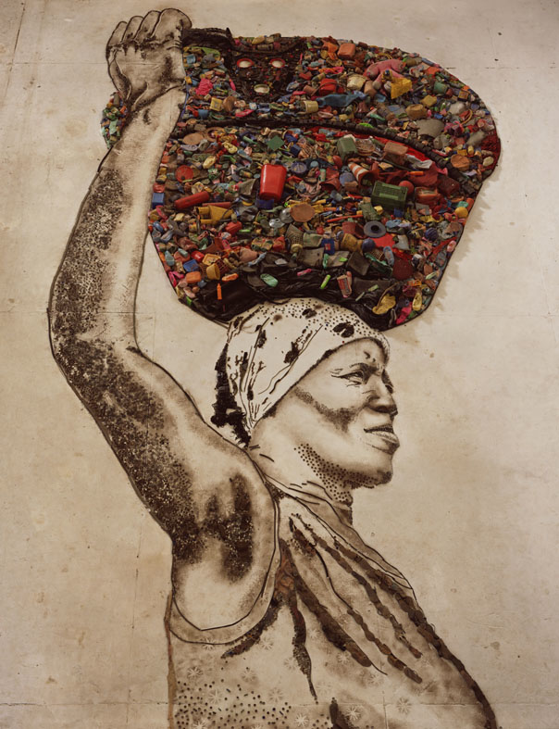
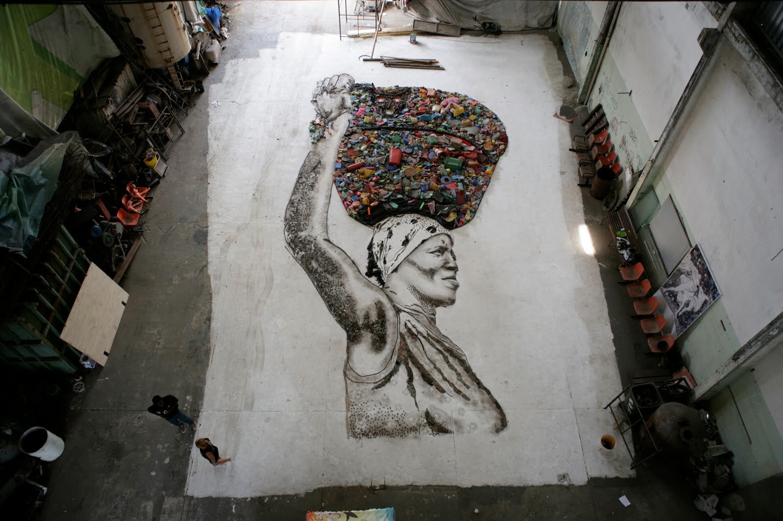

Slide 13
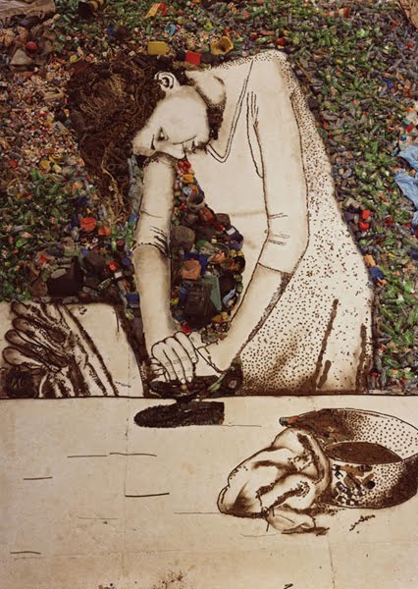
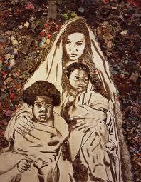

Slide 14
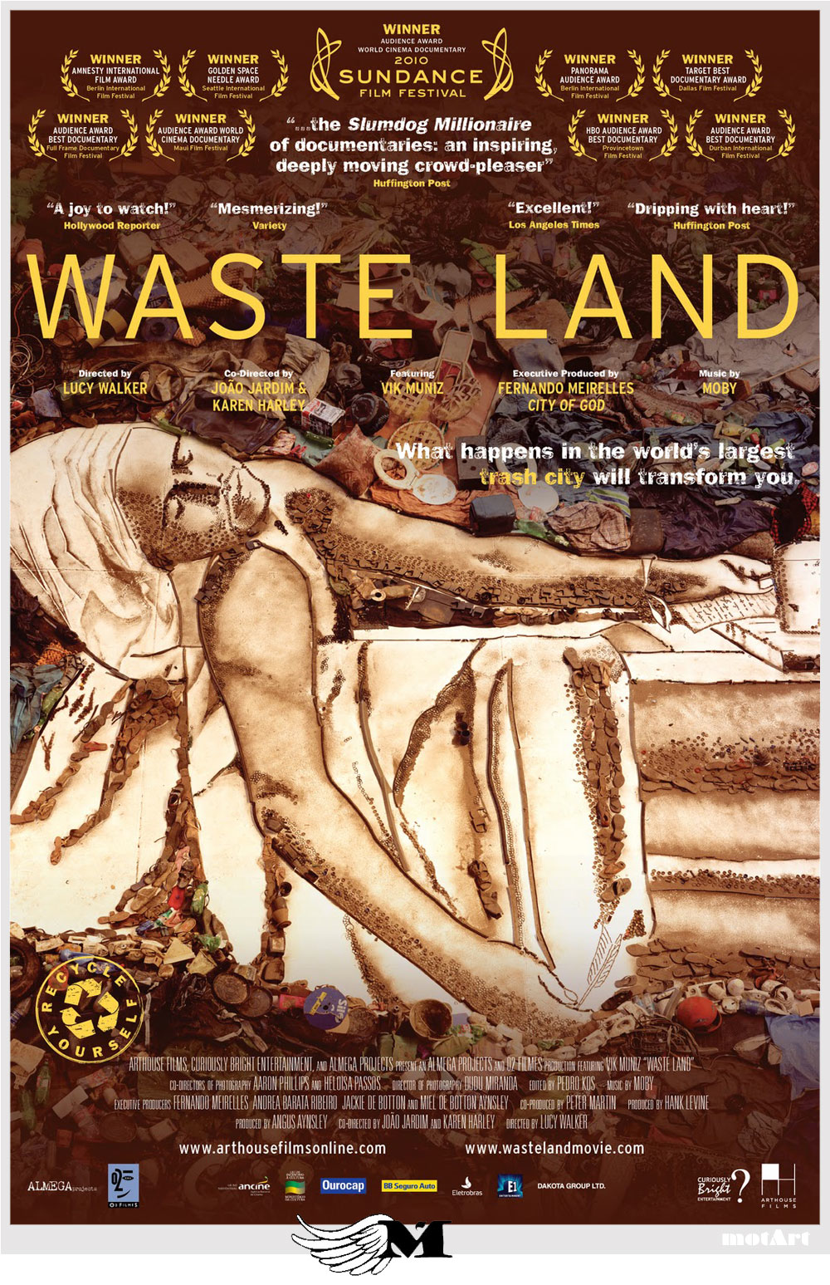
“The really magical things
are the ones that
happen right in front of you,”
he said.
“A lot of the time
you keep looking for beauty,
but it is already there.
And if you look
with a bit more intention,
you see it.” - Muniz

Slide 15
Medium is the Message Project!
What do you want to say through art?
You will make a self portrait and define it through a medium of your choice. (recyclables, collage, buttons, bottle caps, something meaningful to you!)
You will take a picture of yourself on photobooth using the thermal setting, glow setting or comic book setting!
You will make a grid of your face and translate it on a wooden panel.

Slide 16
What is your message? How will the medium show it?

Slide 17
Ideas & Requirements
You must create some form of relief
You must fill entire the wooden panel
You must define your face in some way
You must communicate an idea through your work of art. How does the medium define the meaning?
IDEAS! You can use, paint, newspaper, magazines, 3D objects, trash, fabric, yarn, natural materials, hot glue, pipe cleaners, buttons, bottle caps, beads, objects from your childhood, broken glass, wood….and basically anything you can think of!

Slide 18
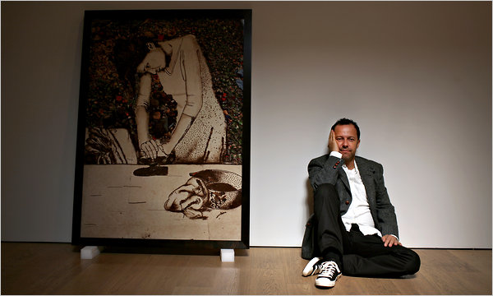
Inspired by Vik Muiz

