Slide 1
Elements of Art

Slide 2
The Elements
The elements (line, shape, form, value and color) are the building blocks of art. All elements are present in some degree in all works of art.

Slide 3
The Element of Line
Used to define space. Uses contours and outlines to suggest mass or volume

Slide 4
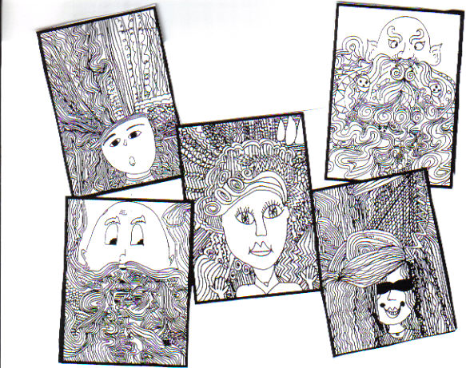
Descriptive Line
Lines that help us understand what we are seeing
You have been making these lines since you picked up a pencil

Slide 5
Types of Descriptive Lines
Outlines
Contour Lines
Hatching
Crosshatching

Slide 6
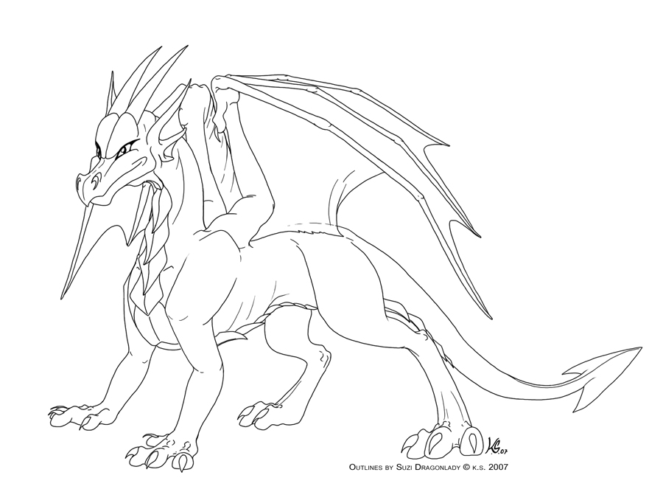
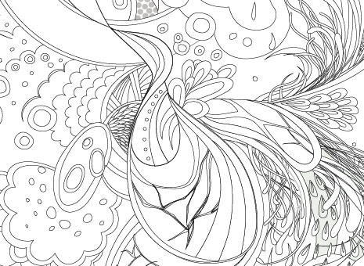
Outlines
Describe the outer edges of shapes which appear flat

Slide 7
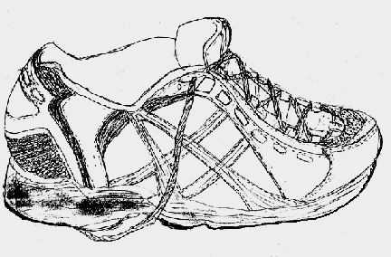
Contour Lines
Define outer edges: vary in thickness : give depth to an object

Slide 8
Hatching
Shading using closely spaced, parallel lines used to suggest light and shadow

Slide 9
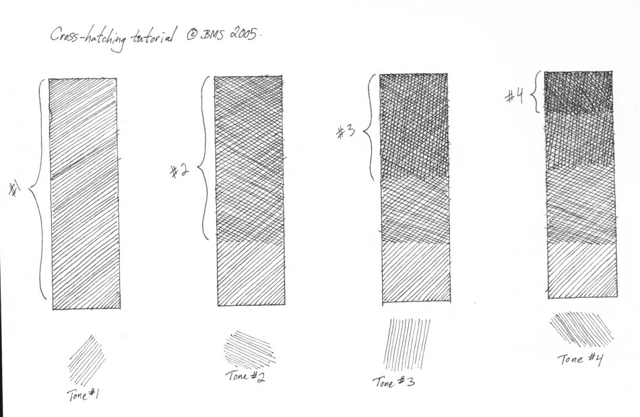
Crosshatching- Shading created by crossed parallel lines

Slide 10
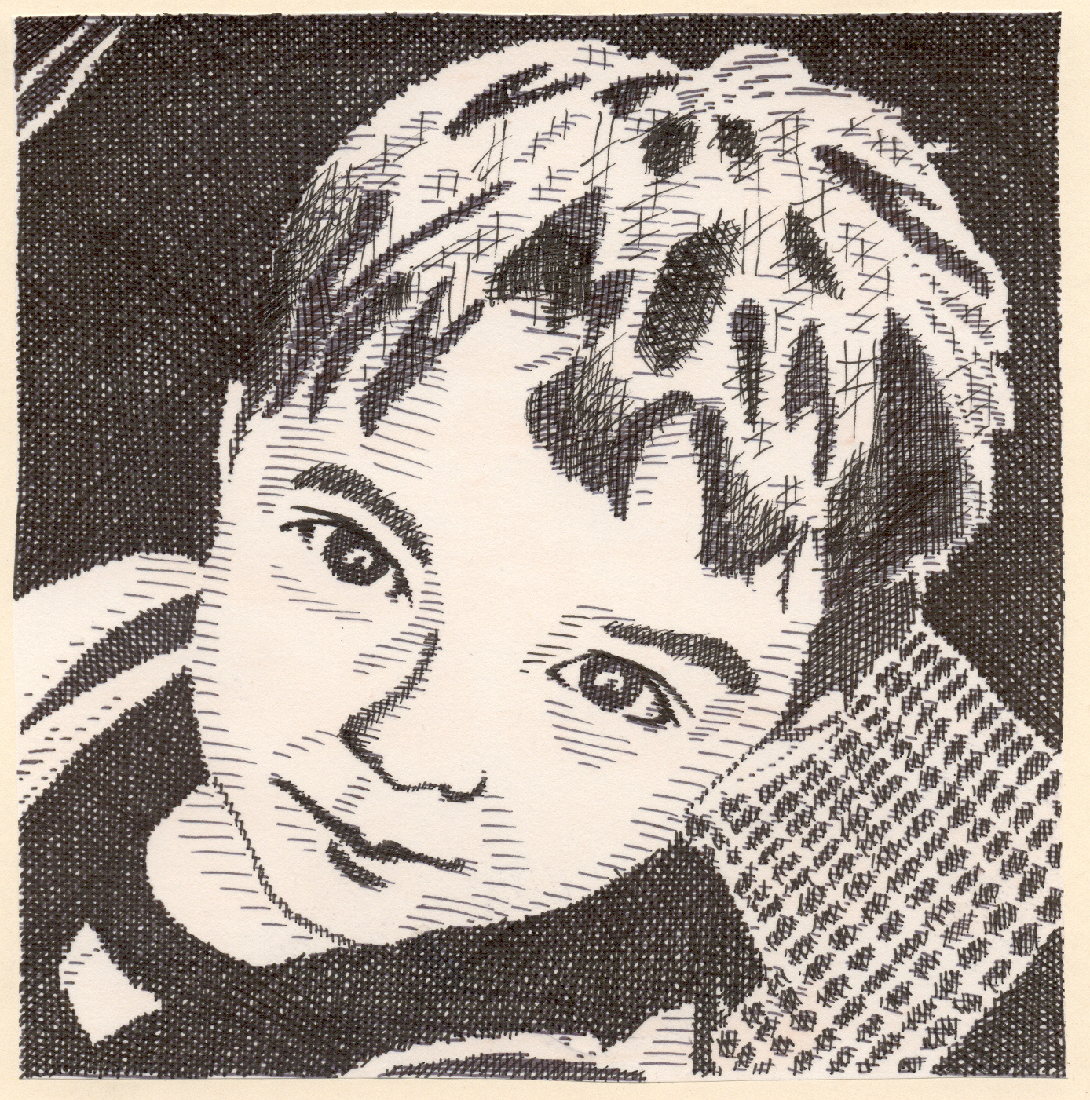
Cross

Slide 11
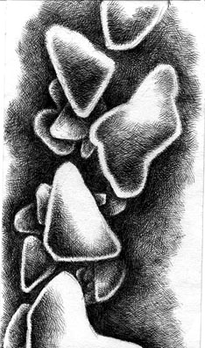
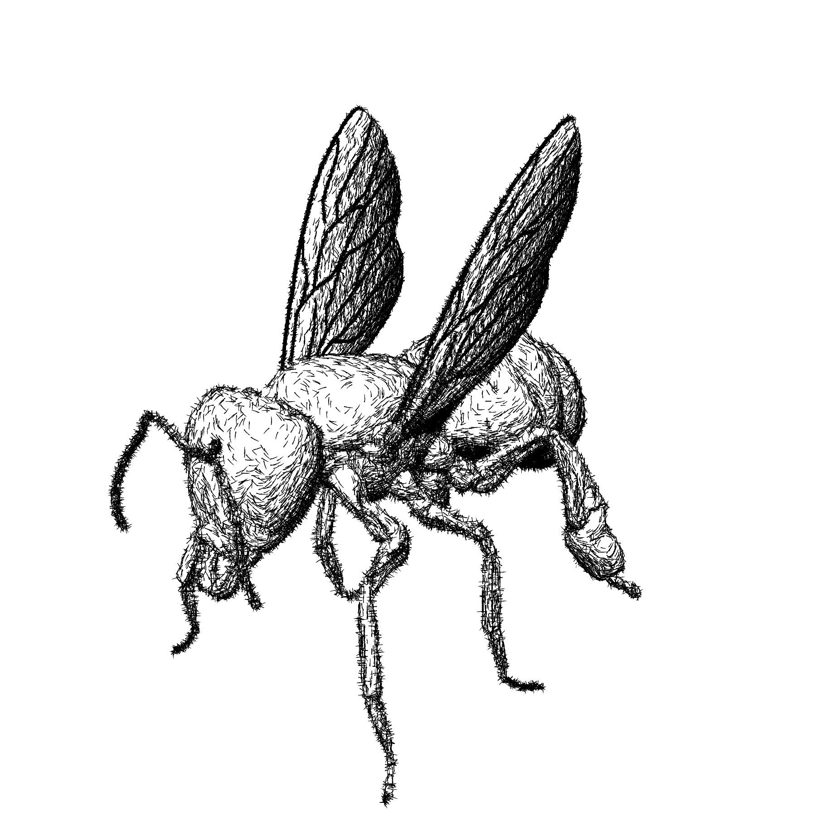
Outlines

Slide 12
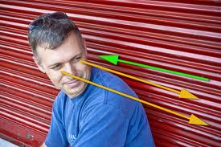
Implied Lines
Suggested by the direction in which figures in a picture are looking, or from the observer’s eye to the object being looked at

Slide 13
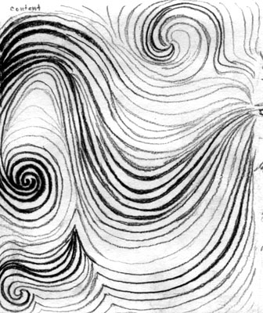
Expressive Lines
Lines that are produced to express an idea, mood or quality (e.g. mean, happy, delicate)

Slide 14
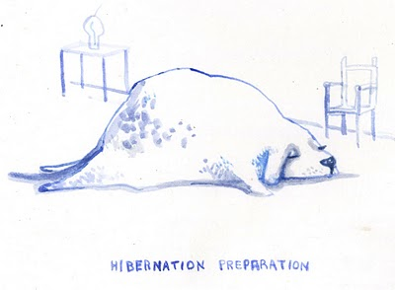

Slide 15
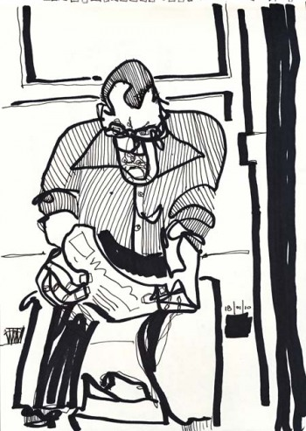

Slide 16
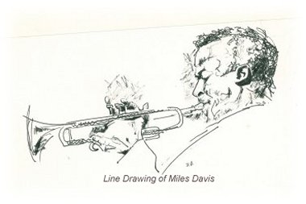

Slide 17
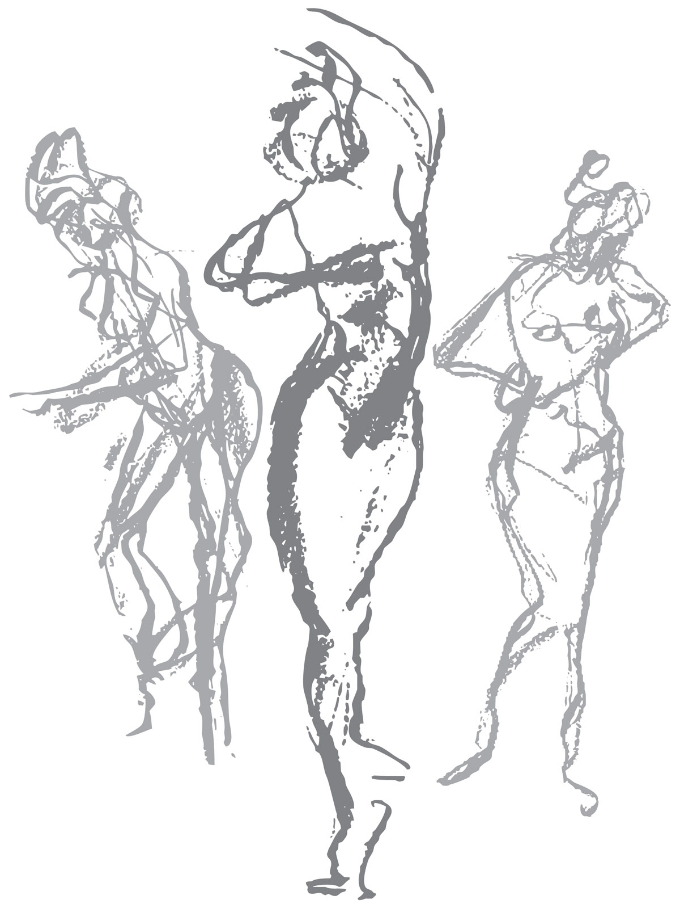
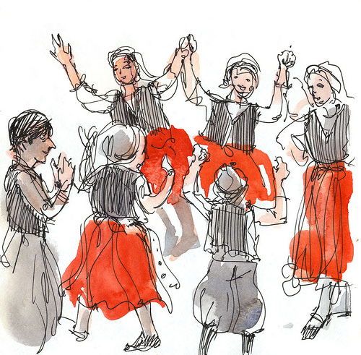
Does the line give the two drawings of dancing a different feeling?

Slide 18
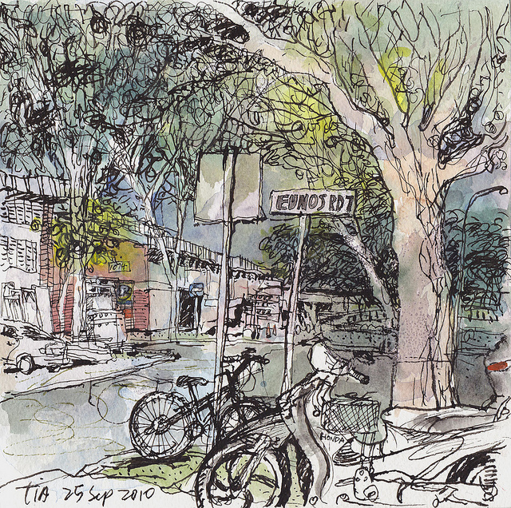
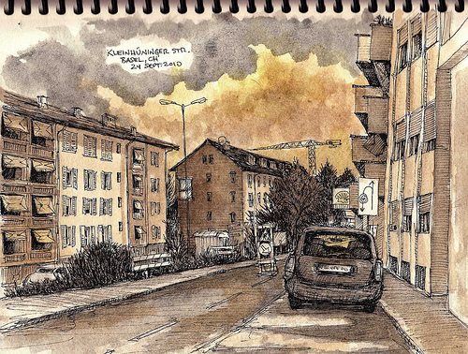
What about the lines give these drawings have a different tone to them even though they have the same subject?

